Slide 1

Spectral Gap Analysis of QWOA under Different Graph Laplacians
Soumyojyoti Dutta
2nd year
M.Tech in Quantum Technology
Indian Institute of Technology Jodhpur
Supervised by : Jason Pye

Slide 2

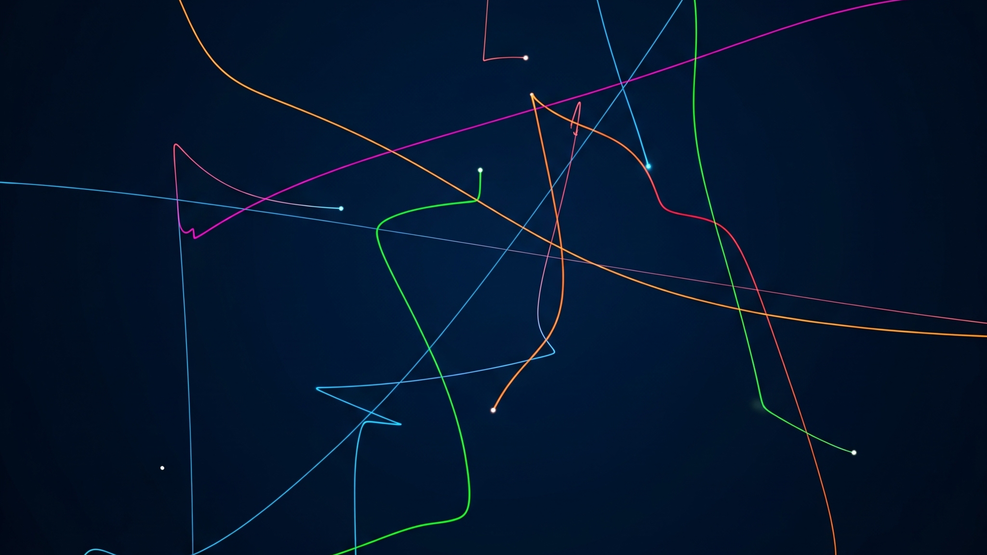
contents
Motivation and objective
What is Random walk ?
What is Qwoa ?
methodology
Results and Summary

Slide 3

Motivation and objective

Slide 4
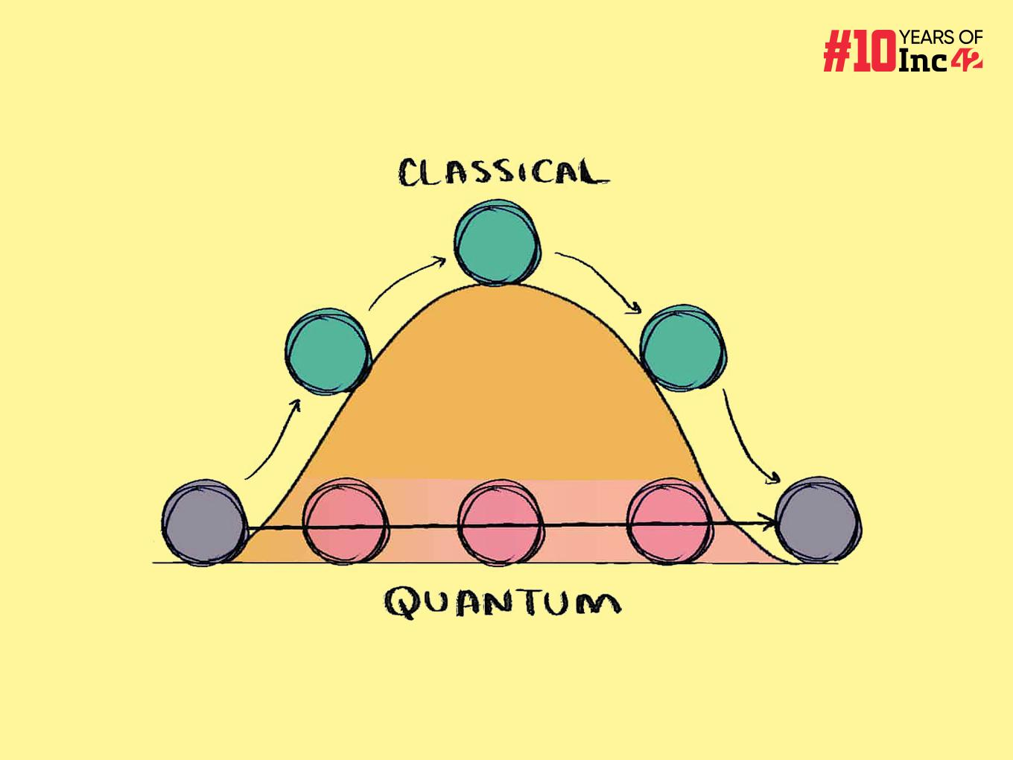
Why do we need quantum algorithms?
Many real-world problems (logistics, finance, drug design, ML hyperparameters) boil down to finding the global minimum in a rugged landscape
Classical algorithms like gradient descent can get stuck in local minima.
Even clever heuristics may take exponential time for certain classes of problems.
But quantum systems can harness the power of superposition to explore multiple paths at once
Quantum interference can cancel “bad” paths and reinforce “good” ones.
Quantum system can use quantum tunneling to avoid getting stuck at local minima

Slide 5
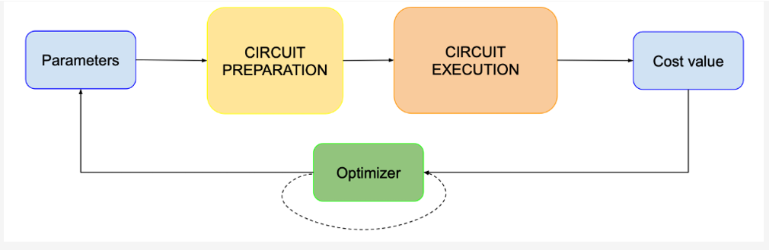
NISQ & VQAs
NISQ Era:
Current quantum devices: noisy, limited qubits, shallow circuits .
Full-scale error correction not yet practical.
Variational Quantum Algorithms:
Hybrid quantum-classical approach.
Suited for NISQ hardware (shallow depth, error resilient).
Includes VQE, QWOA as special/extended cases.

Slide 6
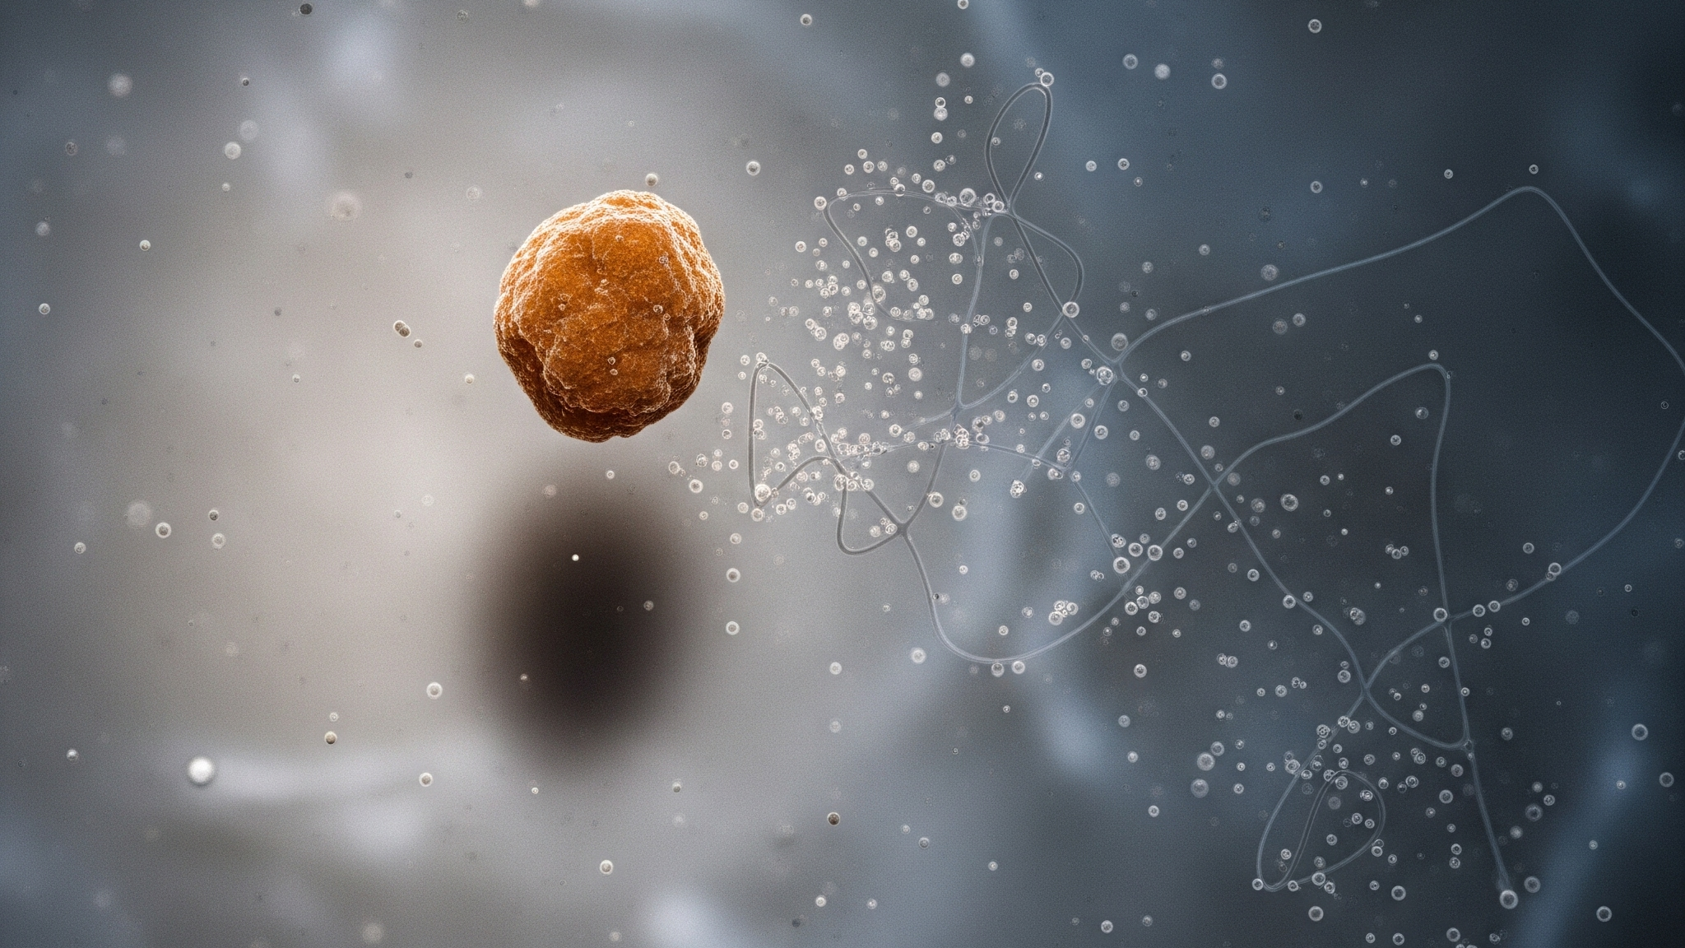
Research Motivation
Variational quantum algorithms (VQAs) like QWOA are usually driven by an ansatz choice — often based on intuition or heuristics
In QWOA, the ansatz is not arbitrary: it is defined by the graph Laplacian, which guides the quantum walk.
Understanding how different graph Laplacians influence optimization dynamics could make ad hoc ansatz design unnecessary
Investigate how graph structure affects the spectral gap of H(s)=(1−s) H_{Q}+ s H_{C}

Slide 7

What is a Random Walk?

Slide 8
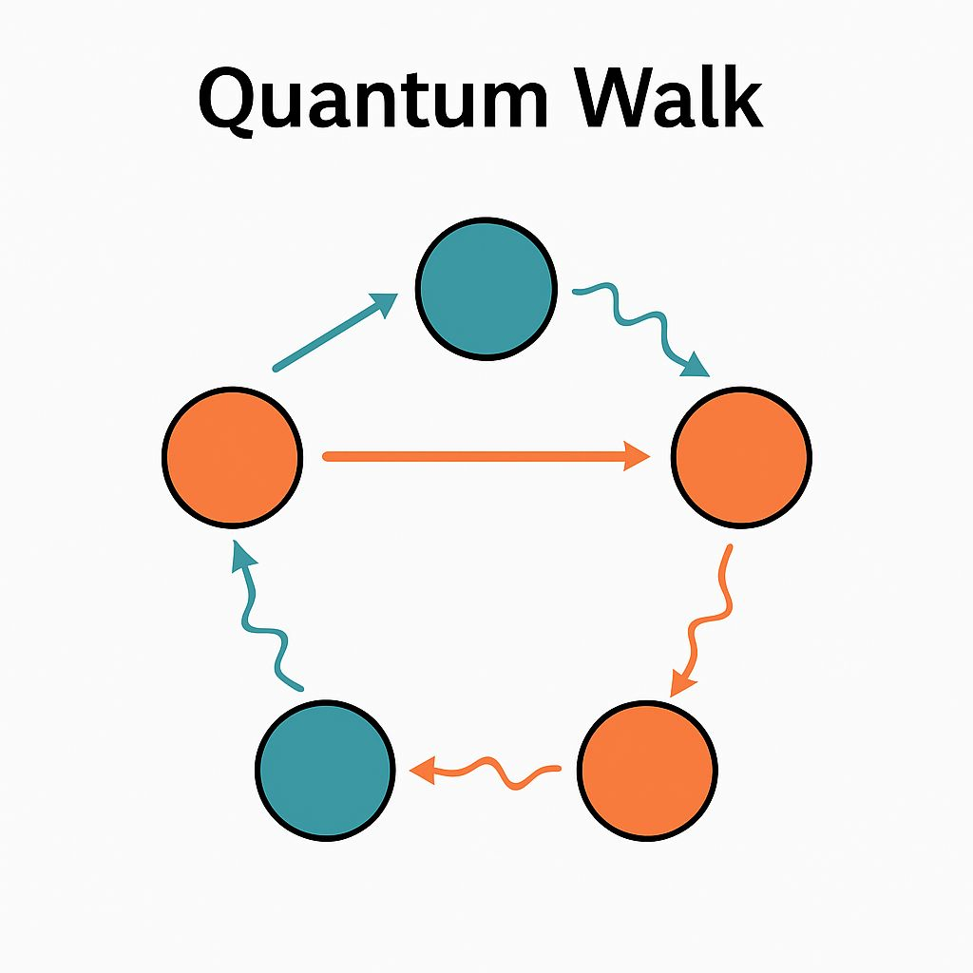
Classical vs Quantum Walk
classical Walk: probabilities, diffusion
Quantum Walk: amplitudes, interference, faster spreading(Ballistic)
Types: discrete-time (with coin operator and shift register), continuous-time (Hamiltonian evolution)

Slide 9
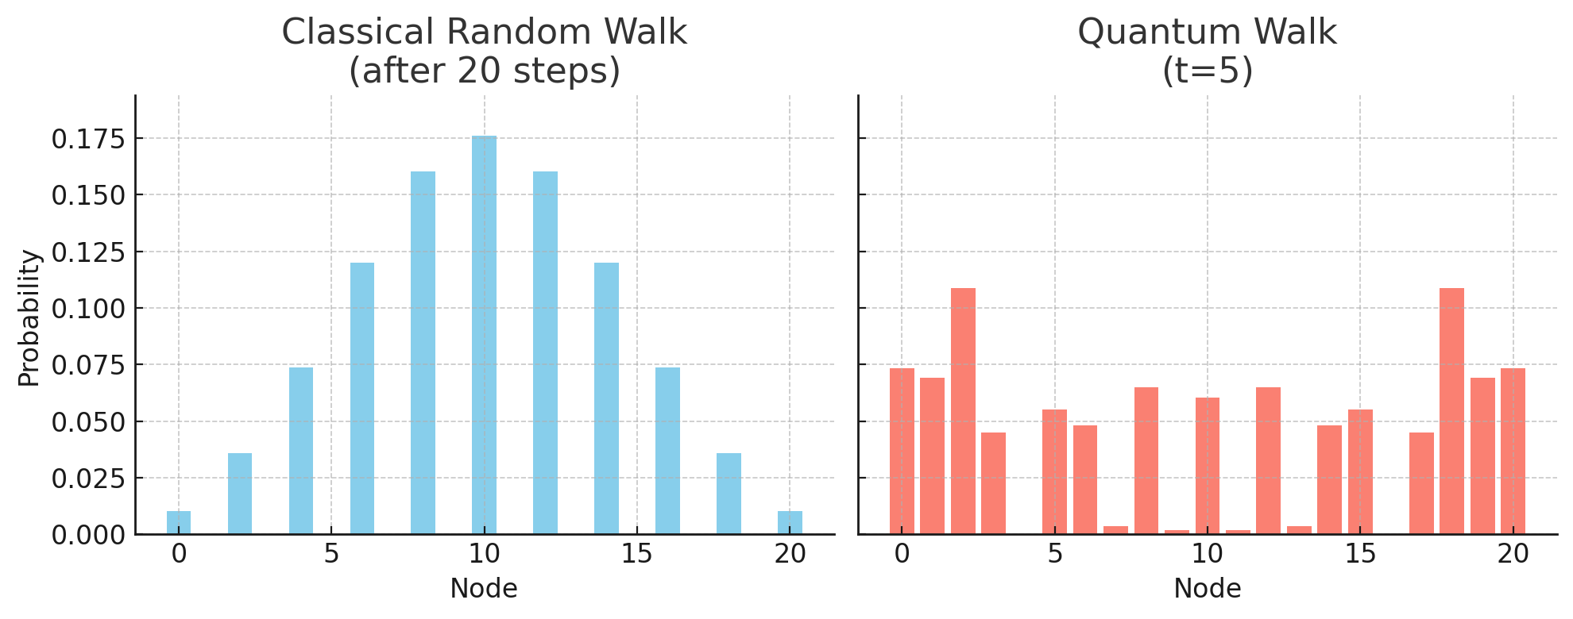

Market overview

Slide 10
What is QWOA?

Slide 11
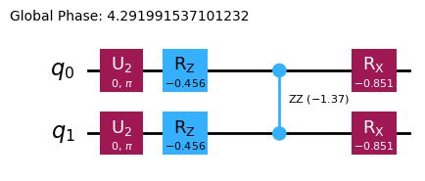
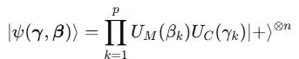
Quantum Walk Optimization Algorithm
QwOA is a gate-model hybrid quantum-classical algorithm for combinatorial optimization. It belongs to variational quantum algorithm class(vqa)
It prepares a quantum state via p layers:
Parameters β_{k}, γ_{k} are tuned (classically) to minimize the cost function.
As p→∞, QAOA approaches adiabatic evolution

Slide 12
Quantum Walk Optimization Algorithm
Uses graph Laplacian H_{Q} as the generator of the “mixer” step.
This makes the exploration problem-structure-aware
The Idea is that The quantum walk naturally respects graph connectivity and can lead to faster exploration of the solution space.
Choosing the right H_{Q}​ (graph topology) could improve performance — this is exactly what we’re investigating.
QAOA and Grover’s algorithm are special cases of qwoa

Slide 13
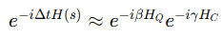
QWOA in the Adiabatic Picture
Adiabatic Interpolation Form:
H(s)=(1−s)H_{Q} + sH_{C}, s∈[0,1]
H_{Q}​: Quantum walk generator from graph Laplacian.
H_{C}​: Cost Hamiltonian (diagonal, encodes objective).
Mapping to QWOA Gates (via Trotterization): Discretize time evolution into p steps
This is exactly the QWOA layer.

Slide 14
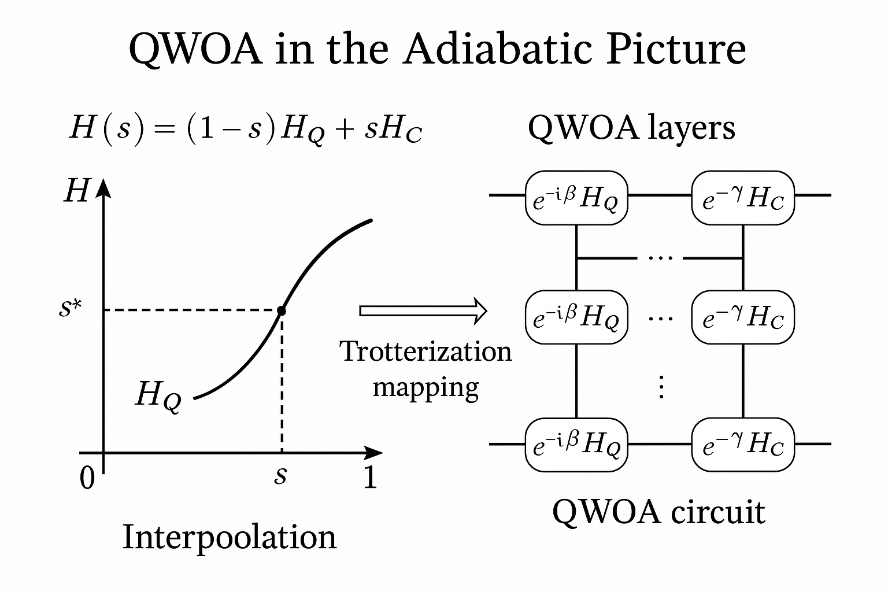
QWOA in the Adiabatic Picture
Adiabatic picture → continuous walk from initial uniform superposition to cost state.
Gate picture → stroboscopic walk, alternating H_{Q​} and H_{C}​ unitaries.
Both are governed by the same Hamiltonians, so spectral gap behavior in the adiabatic case tells you about QWOA hardness.

Slide 15
methodology

Slide 16
methodology
Each graph defines H_{Q} via the Laplacian L=D−A (degree matrix minus adjacency matrix).
Cost Hamiltonian: H_{C​} diagonal with toy objective function.
Interpolation:
Evaluate full spectrum for s∈[0,1] in small steps.
Find minimum gap Δ_{min}⁡ and location s∗

Slide 17
Results and summary

Slide 18
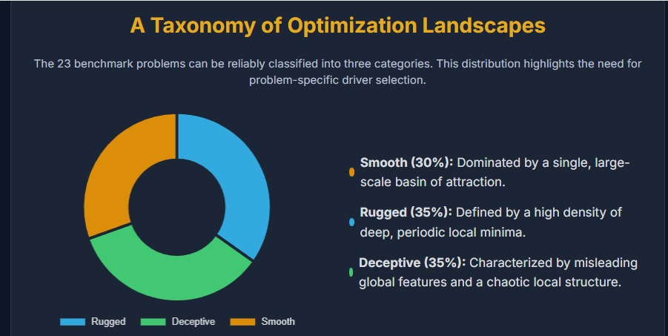
Market overview
results

Slide 19
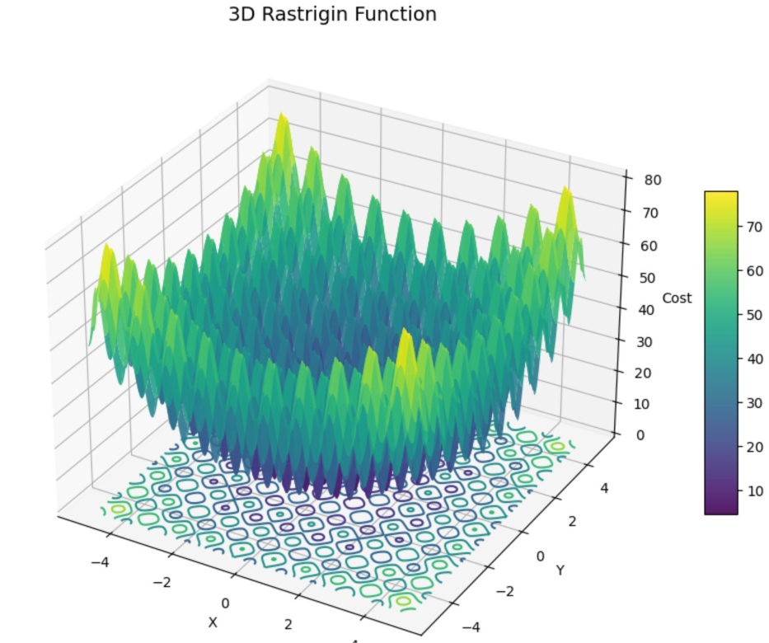
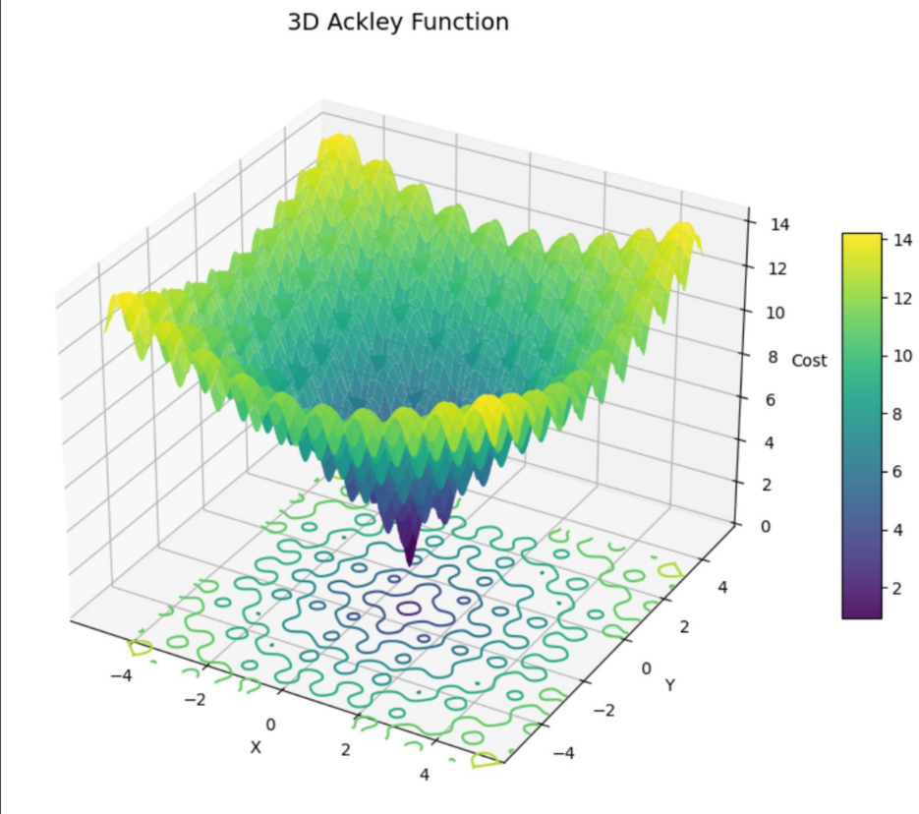
Market overview
Cost landscapes

Slide 20
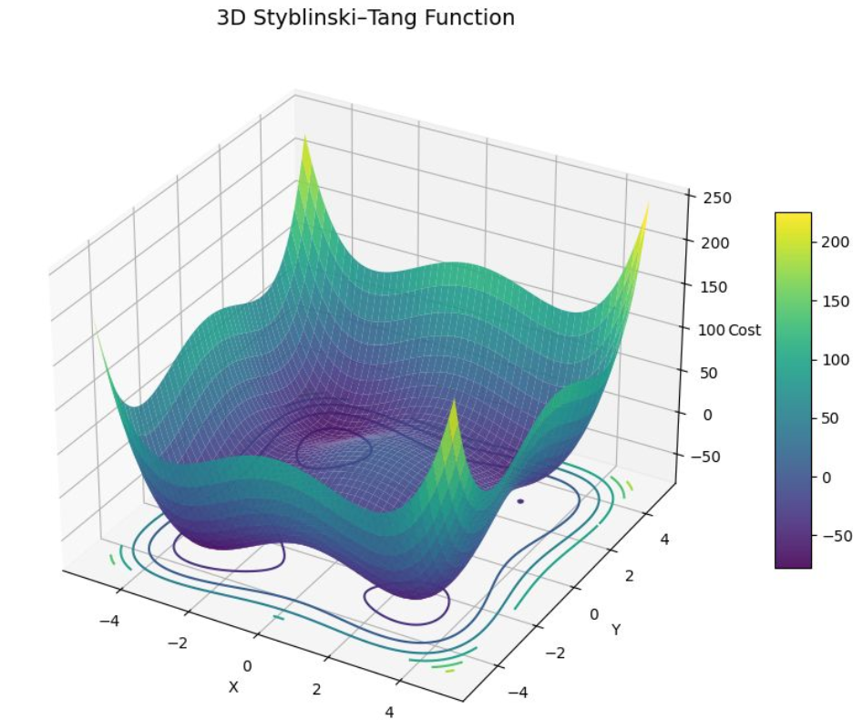
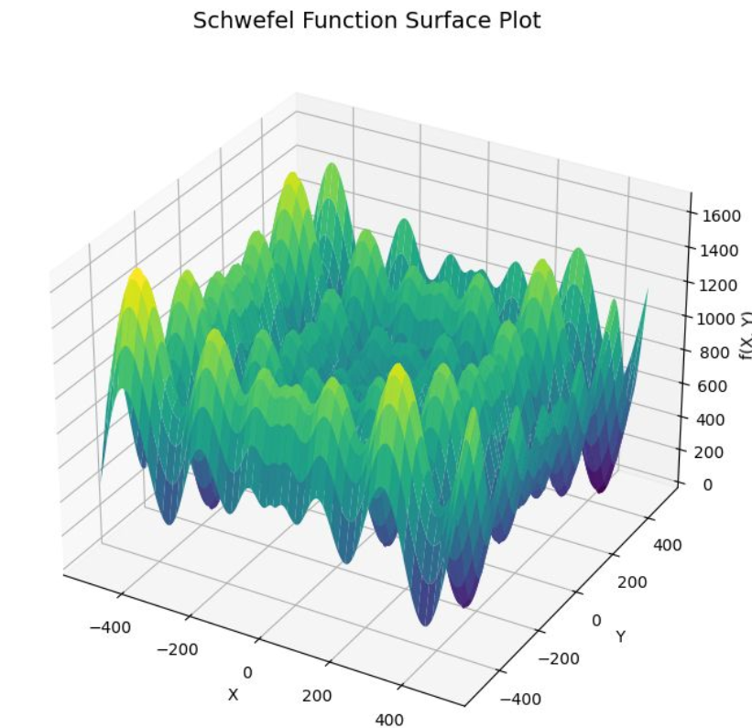
Market overview
Cost landscapes

Slide 21
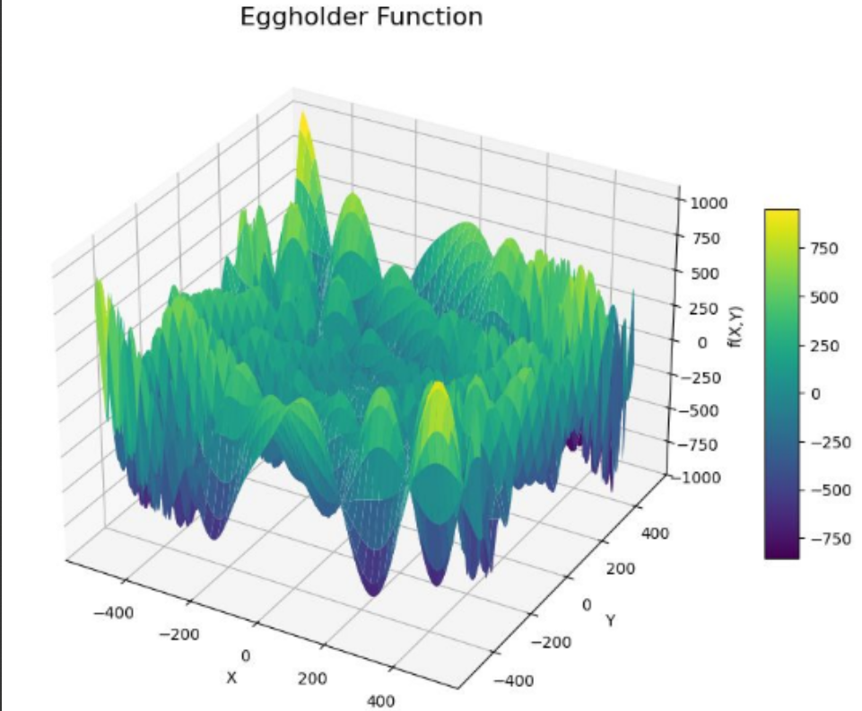
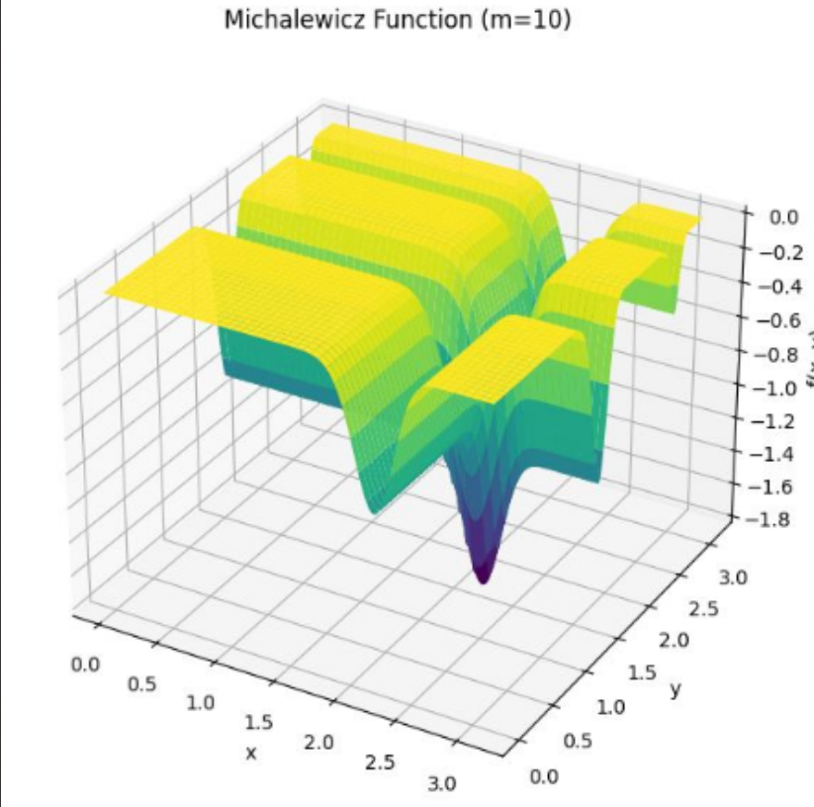
Market overview
Cost landscapes

Slide 22
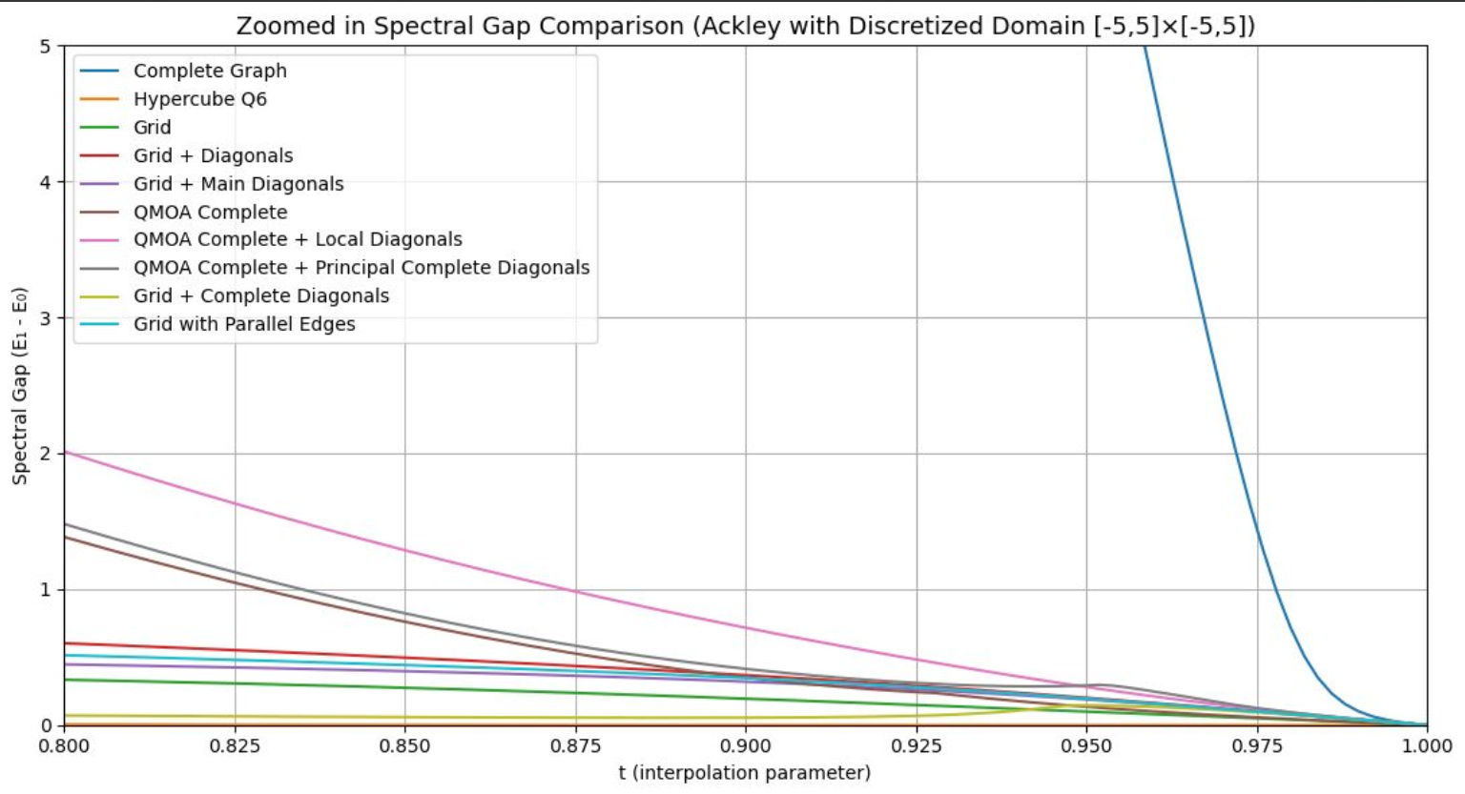
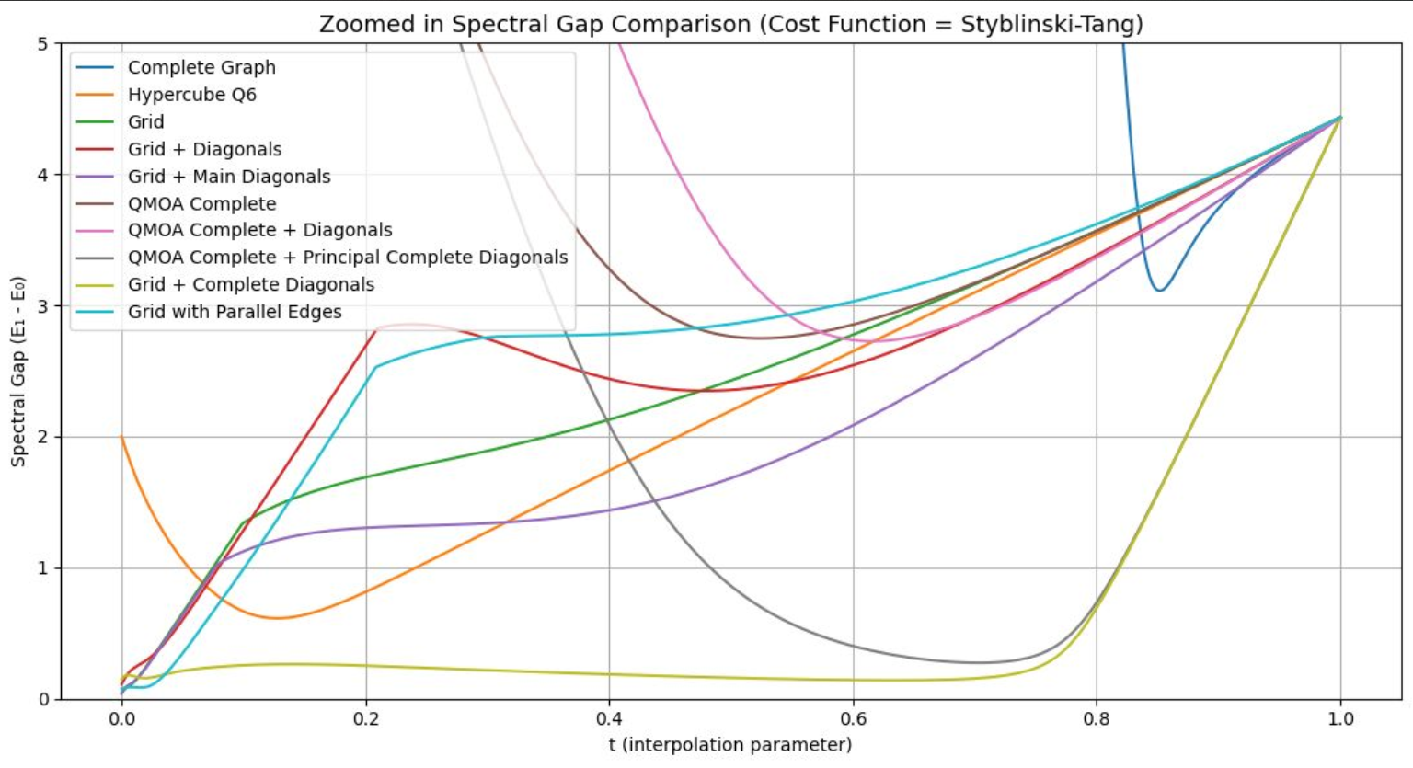
Market overview
results

Slide 23
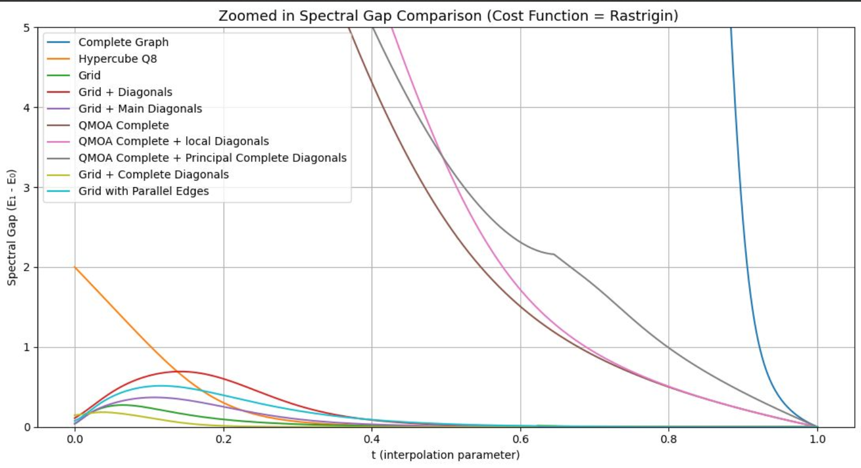
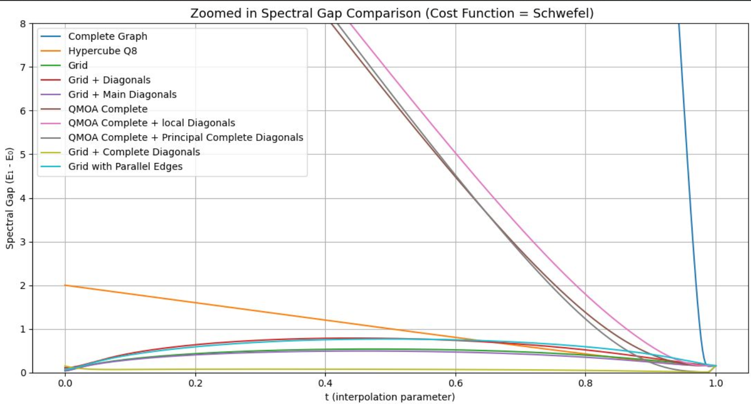
Market overview
results

Slide 24
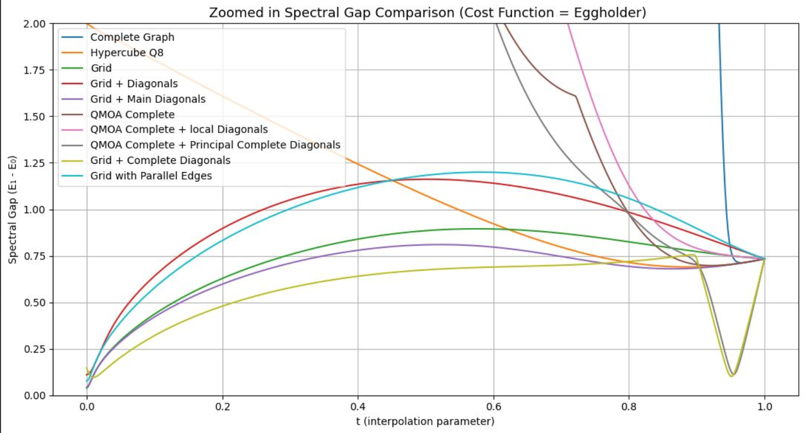
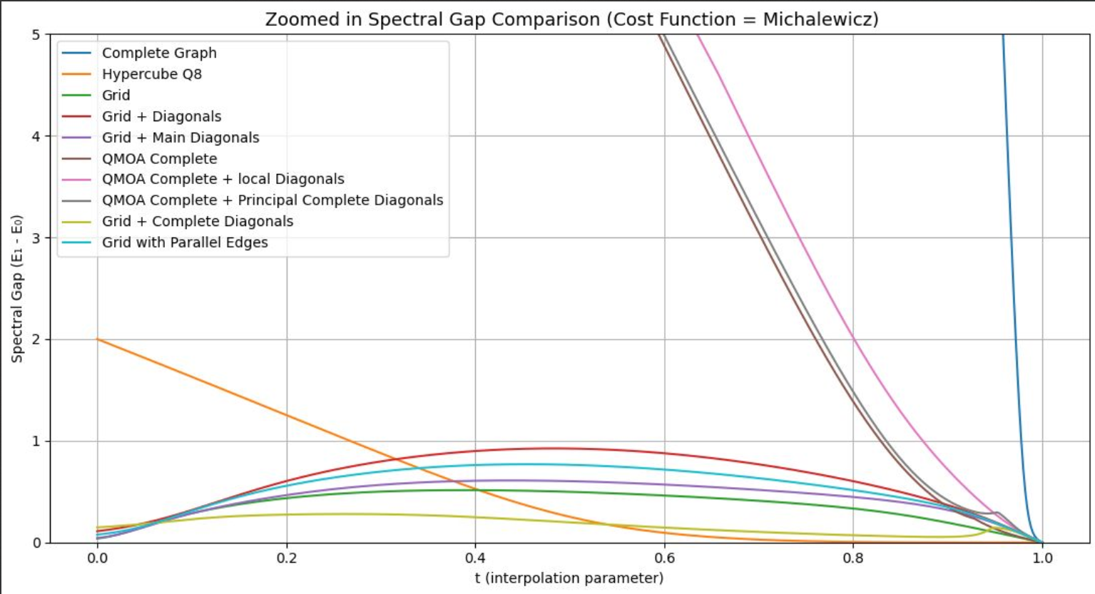
Market overview
results

Slide 25
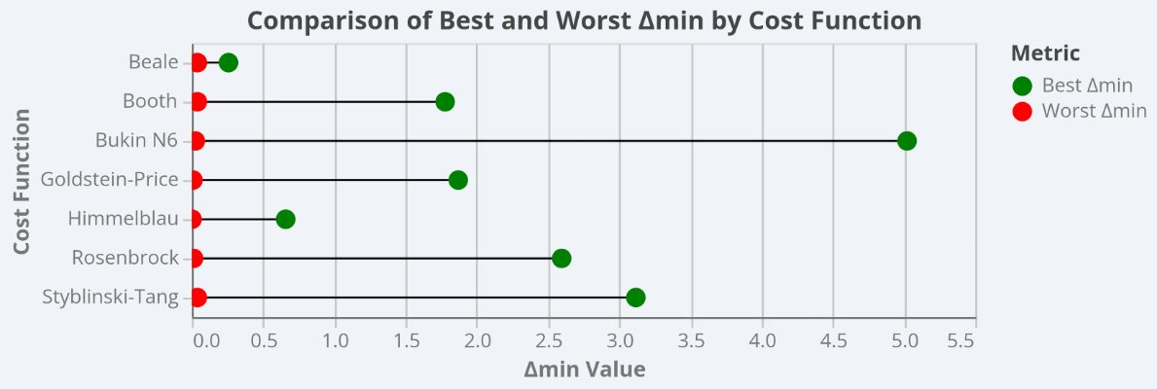
Market overview
results

Slide 26
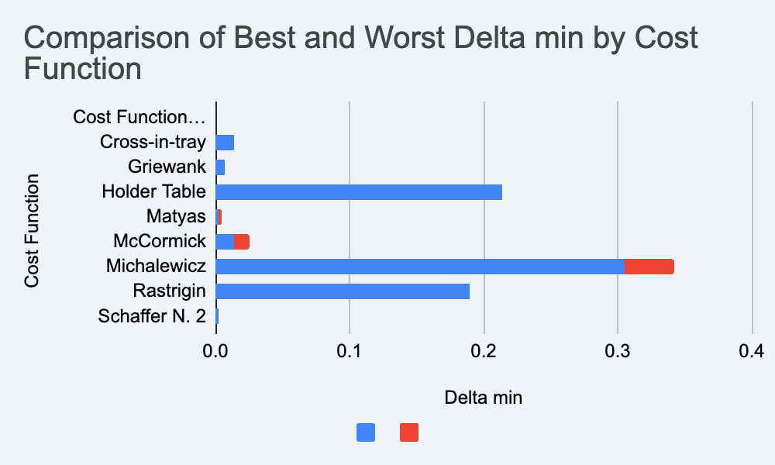
Market overview
results

Slide 27
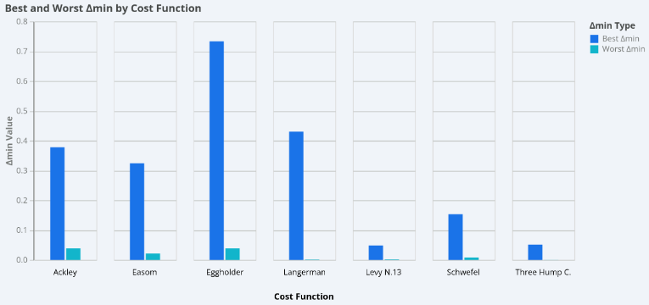
Market overview
results

Slide 28
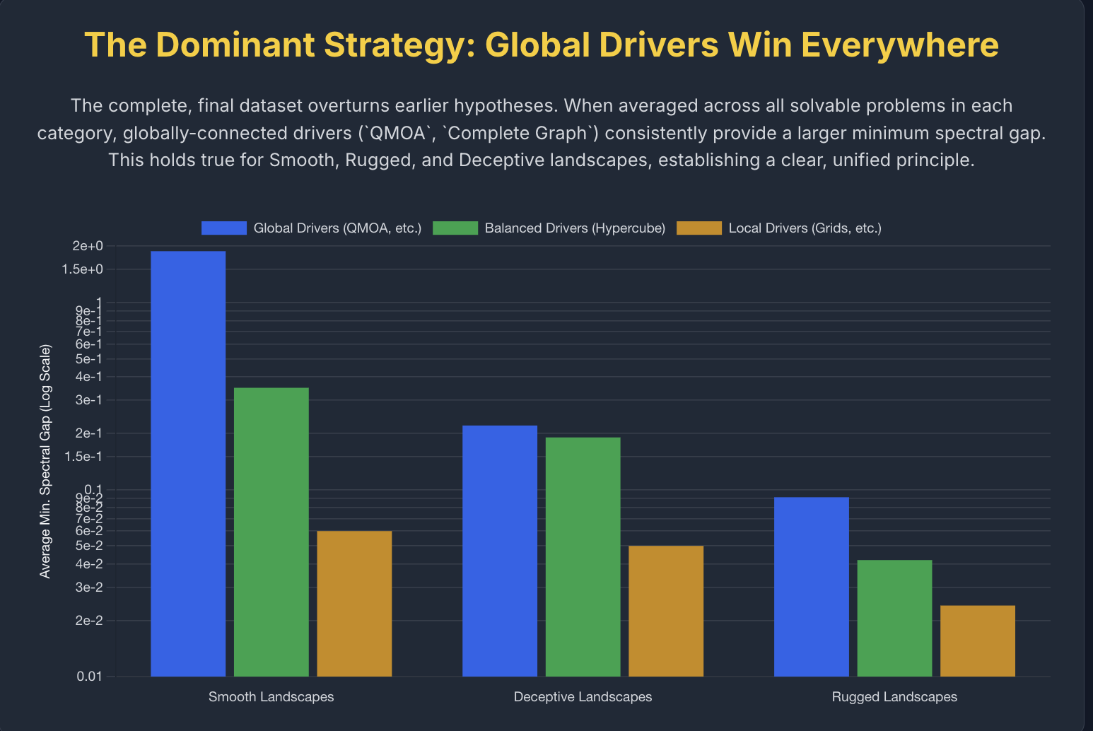
Market overview
results

Slide 29
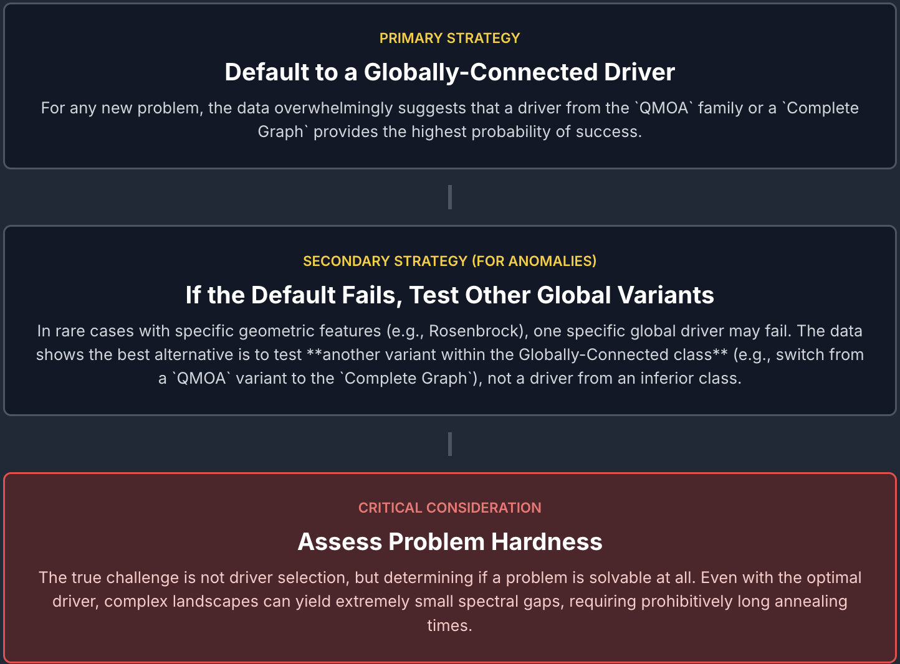
Market overview
Summary

Slide 30
Future work
Extending to larger graphs: Analyze QWOA spectral gaps on bigger or more complex graph classes.
Role of entanglement: Study how entanglement affect gap behavior and solution quality.
Comparison of approaches: Compare adiabatic insights with gate-based QWOA to understand if there is any difference in solutions and the mechanism behind it
Alternative mixers: Explore other Hamiltonians beyond graph Laplacians for better optimization landscapes.
Application-oriented tests: Apply QWOA to real-world combinatorial problems (e.g., traffic networks, logistics).

Slide 31

Thank you

